Slide 1
Chronic Hepatitis
Prof Anuradha Dassanayake

Slide 2
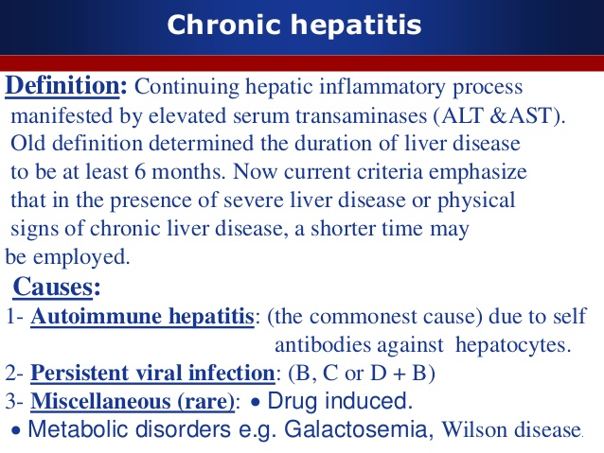

Slide 3
Causes
Viruses
B & C
Autoimmune
AIH
PSC
PBC
Drugs/Herbs
Metabolic liver disease
Wilsons/Haemochromatosis
NASH/Alcohol

Slide 4
Chronic Hepatitis B
Chances of chronic hepatitis is more if acquire the illness in childhood
If untreated progresses to cirrhosis and HCC in a majority
Presents with generalized ill health or even with cirrhosis or even HCC
Diagnosis by Serology/Liver biopsy/ Viral load
Treatment
Anti virals
Lamivudine
Tenofovir
Entacavir
Immunomodulators
PEG interferon

Slide 5
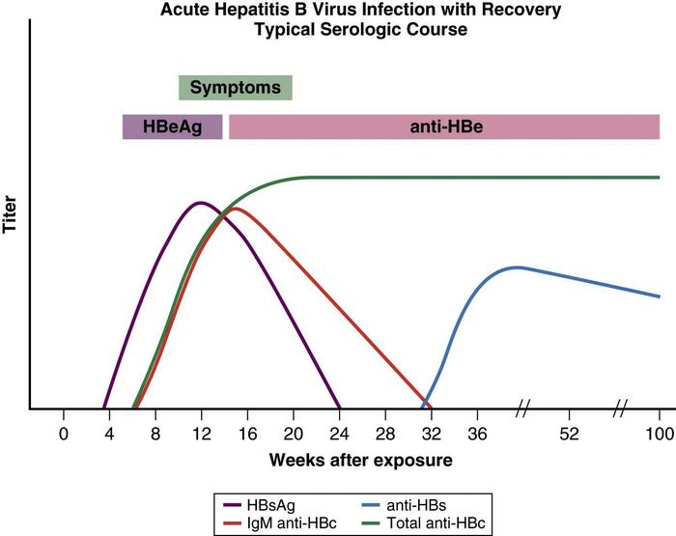

Slide 6
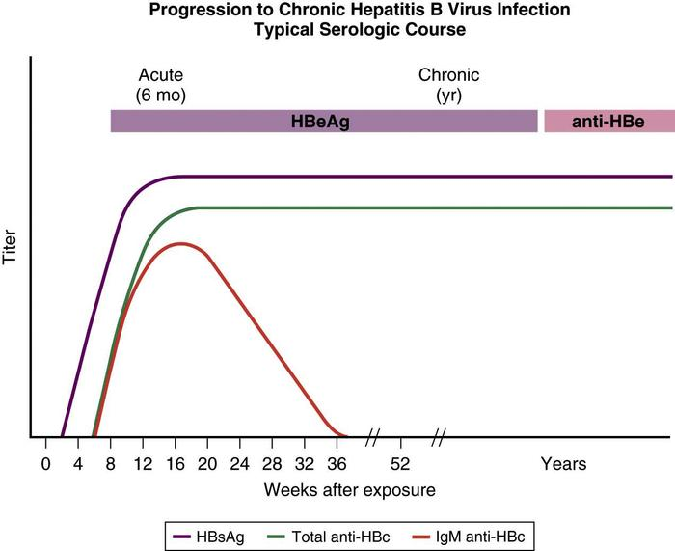

Slide 7
Chronic Hepatitis C
Slowly progressing illness – cirrhosis/HCC over 20-30 years. Drug abusers/Multiple blood transfusions
Rare herein SL/Very common in some other countries
Various genotypes 1 -6
Diagnosis
Hep C antibody/Viral studies(RNA assay)/ Biopsy/Fibroscan
Treatment
Antivirals
Sofosbuvir/Valpatasvir/Ledipasvir/Daclatasvir/Ribavirin
PEG interferon

Slide 8
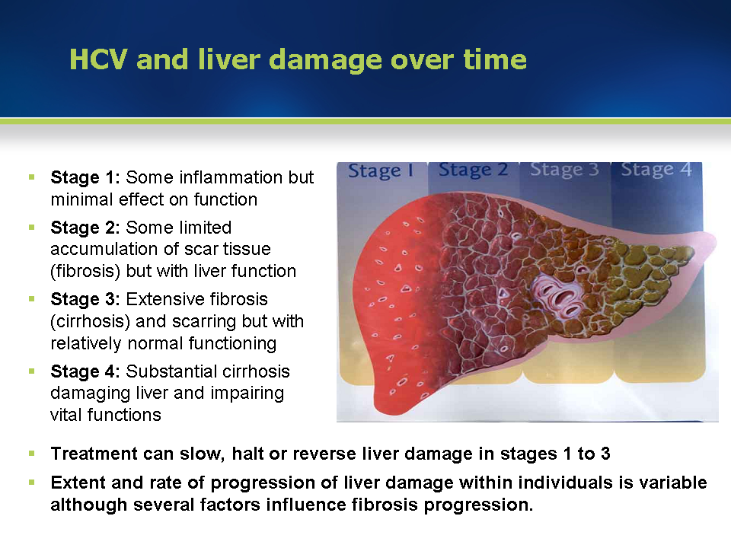

Slide 9
Auto immune liver diseases
AIH
PBC
PSC

Slide 10
Autoimmune hepatitis
Common in females
Present with acute or chronic Hepatitis or cirrhosis
Serum globulins especially Ig G is high
Antibodies are present
ANF/ASA
Biopsy diagnostic- Interphase hepatitis
Very good response to Steroids/Azathioprine
Maintanece of prednisolone 10mg/d + Azathioprine 50mg/d
Has to be treated for 3-5 years
Drugs can be tailed off by if relapses treatment is for life

Slide 11
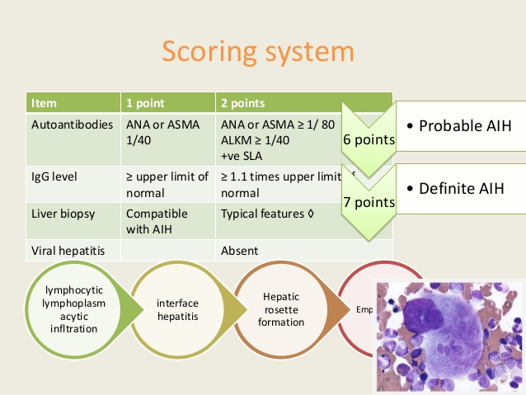

Slide 12
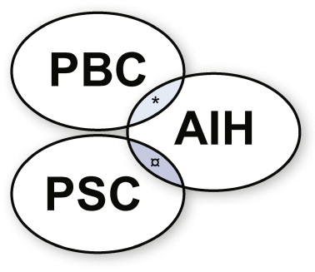

Slide 13
PBC
Disease of the middle aged females
AMA positive
Presents with pruritus
Urso deoxycholic acid is beneficial in the treatment
Obeticholic acid recently approved for PBC

Slide 14
Ursodeoxycholic acid
Is secondary bile acid
Facilitates bile flow through the liver and protects the liver cells
Useful in cholestatic liver disease
PBC
PSC
ICP
Other diseases with cholestasis

Slide 15
PSC
Disease of the young males
Mostly secondary to IBD
Diagnosis is by MRCP/ERCP

Slide 16
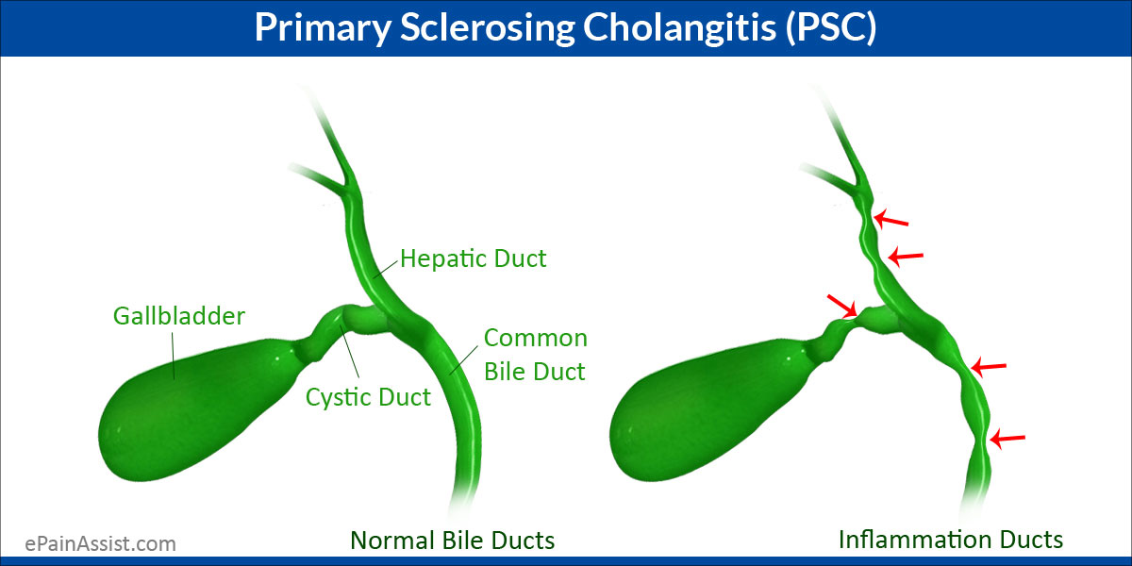

Slide 17
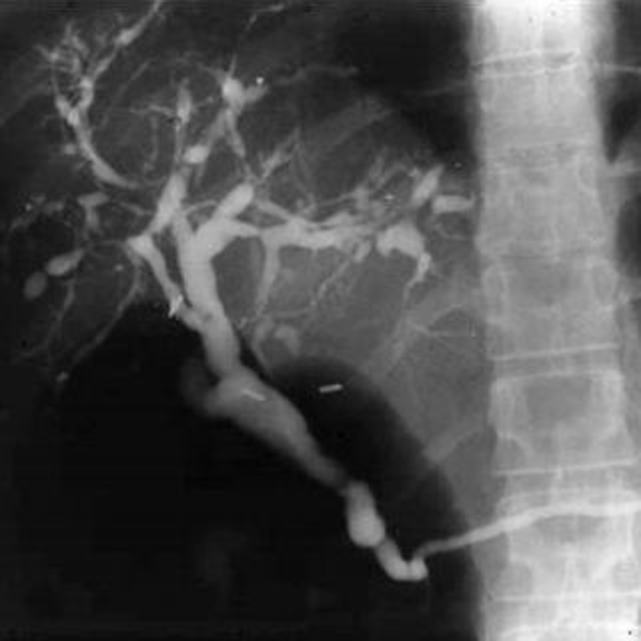

Slide 18
Wilsons Disease
Inherited illness of Cu metabolism
Liver disease presents in child hood
Adults present with neurological illness
Diagnosis by serum caeruloplasmin levels and cu excretion in urine
KF ring
Treated with Cu chelating agents.
Penicillamine
Trientin
Zinc

Slide 19
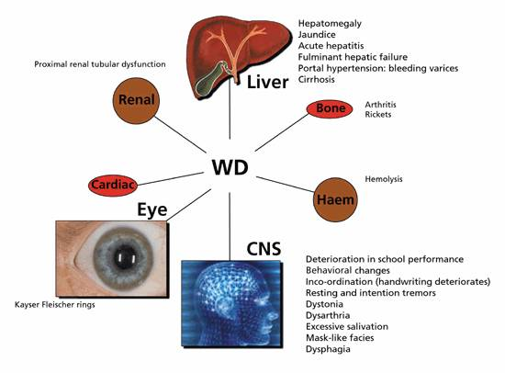

Slide 20
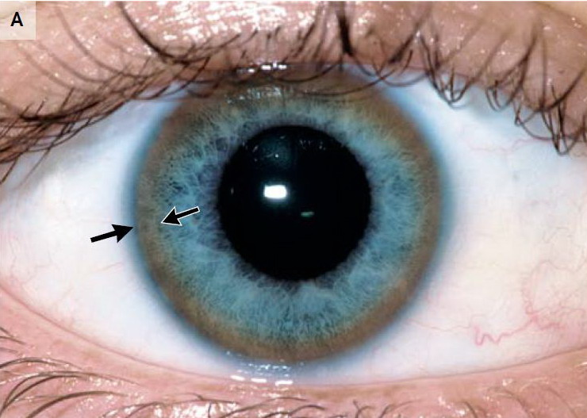

Slide 21
Haemochromatosis
Genetic illness (HFE gene) with the defect is in the duodenal mucosal cell
Disease of the white Caucaseans
Increasesd iron absorption
Rare in females
Secondary iron overload in Haemoglobinopathies , Alcohol abuse and NASH
Treatment is by Venesection
Iron chelation (Deferasirox) useful in patients with anaemia

Slide 22
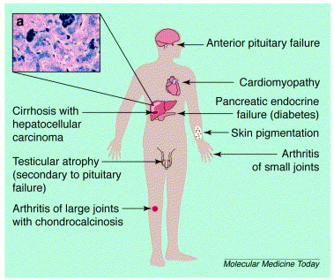

Slide 23
Non alcoholic steatohepatitis
Weight reduction
Mediterranean diet
Exercise
Treatment of cormobidities
DM
Hypertension
Hyperlipidaemia
NASH specific treatment
Vit E
Pioglitazone
Obeticholic acid
Elafibranor

Slide 24
Statins and liver
Statins are safe in patients with NASH
Statins may be indirectly beneficial in NASH
Statins are indicated in Patients with NASH for their frequent comorbid conditions
Statins frequently used in PBC
Statins may be beneficial in patients with well compenstaed cirrhosis

Slide 25
Alcoholic Hepatitis
Abstinence
Steroids

